Slide 1
Neural Additive Models: Interpretable Machine Learning with Neural Nets
July 5, 2022
Gwangwoo Kim

Slide 2
Contents
Review
Neural Additive Models (NAMs)
Evaluating the Accuracy of NAMs
Unique Capabilities of NAMs

Slide 3
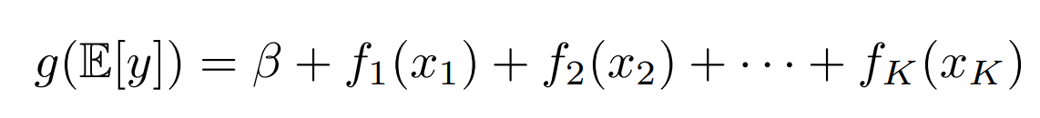
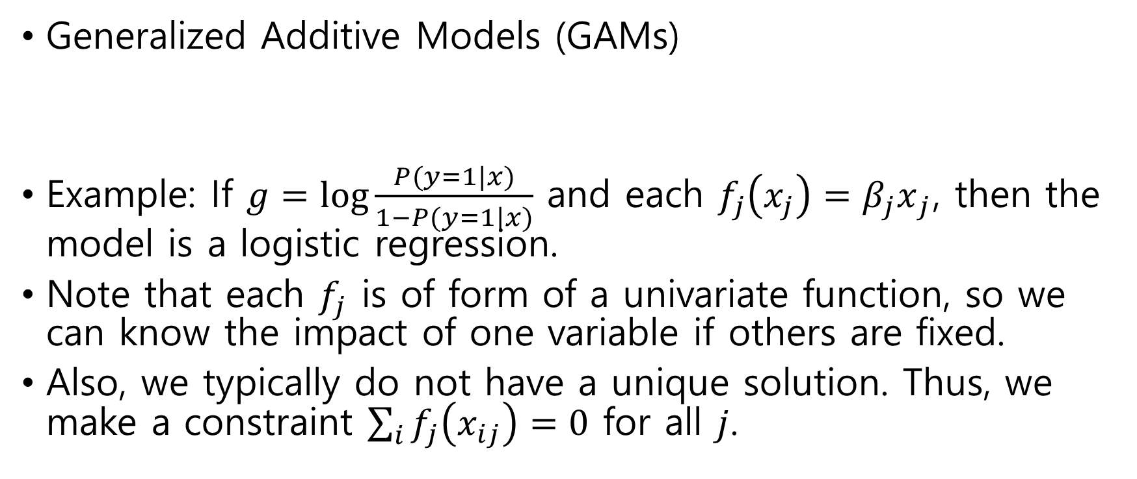
1. Review
Generalized Additive Models (GAMs)
Example: If $g=\log{\frac{P(y=1|x)}{1−P(y=1|x)}}$ and each $f_{j}\left(x_{j}\right)={β_{j}x}_{j}$, then the model is a logistic regression.
Note that each $f_{j}$ is of form of a univariate function, so we can know the impact of one variable if others are fixed.
Also, we typically do not have a unique solution. Thus, we make a constraint $\sum_{i}{f_{j}\left(x_{ij}\right)=0}$ for all $j$.

Slide 4
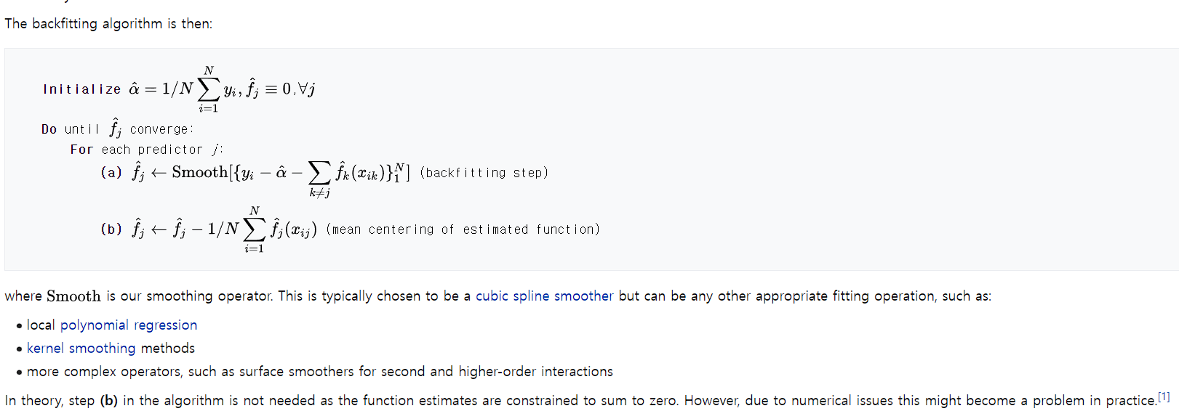
1. Review

Slide 5
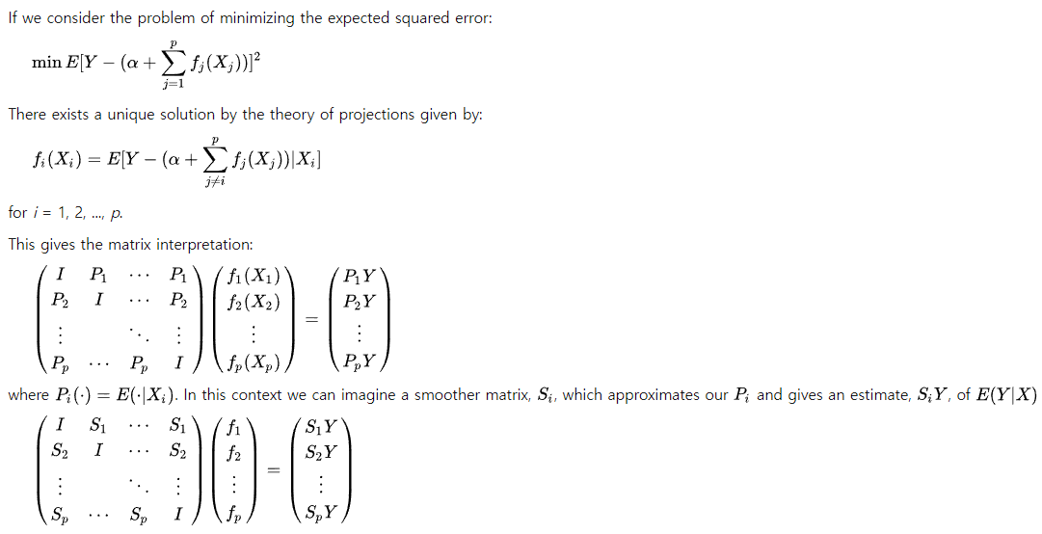

1. Review
by using Gauss-Seidel method

Slide 6
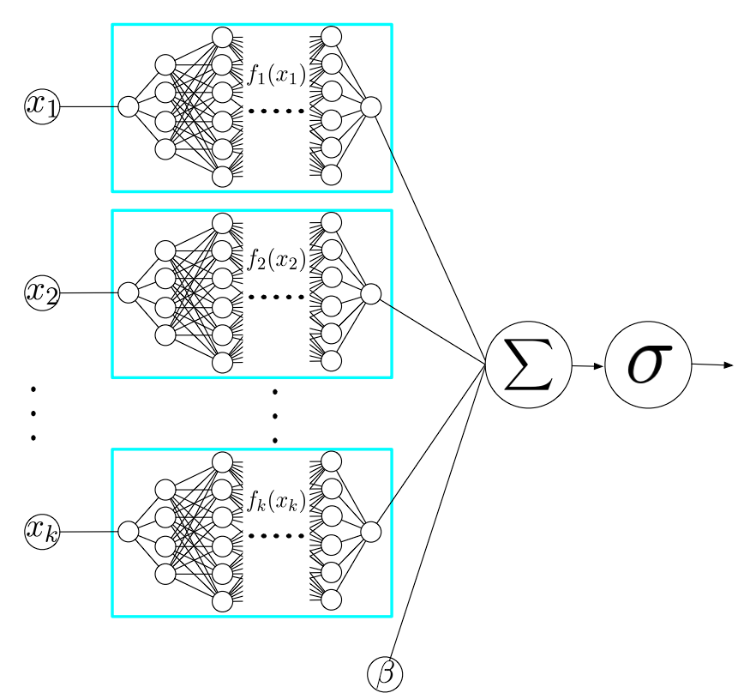

2. Neural Additive Models (NAMs)
In the case of GAMs, if we parametrize each $f_{j}$ to be a neural network, then these networks are still trained jointly by using backpropagation.

Slide 7
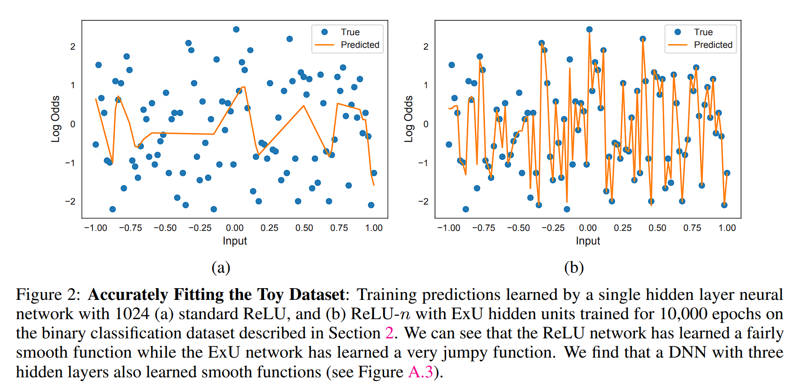
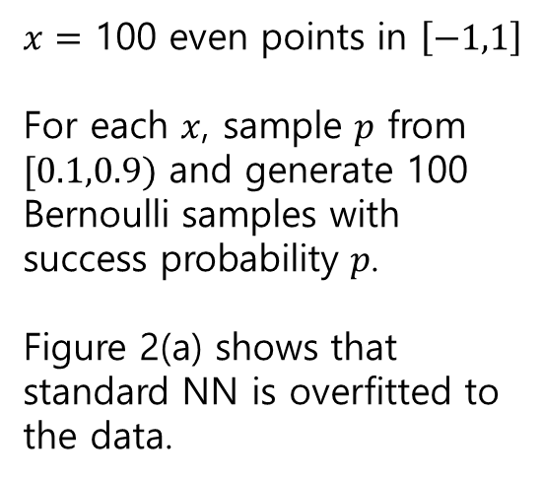
2. Neural Additive Models (NAMs)
$x=$ 100 even points in $\left[−1,1\right]$
For each $x$, sample $p$ from $[0.1,0.9)$ and generate 100 Bernoulli samples with success probability $p$.
Figure 2(a) shows that standard NN is overfitted to the data.

Slide 8
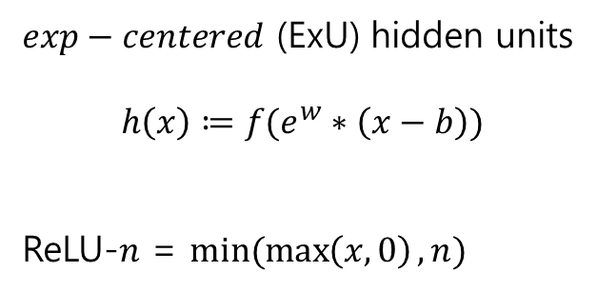
2. Neural Additive Models (NAMs)
$exp−centered$ (ExU) hidden units
$$h\left(x\right)≔f(e^{w}∗\left(x−b\right))$$
ReLU-$n$ = $min⁡(\max\left(x,0\right),n)$

Slide 9
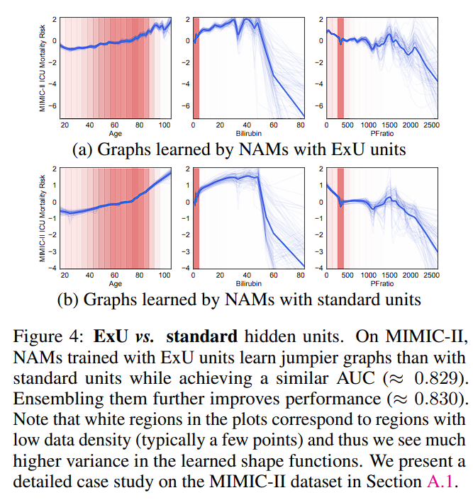
2. Neural Additive Models (NAMs)

Slide 10
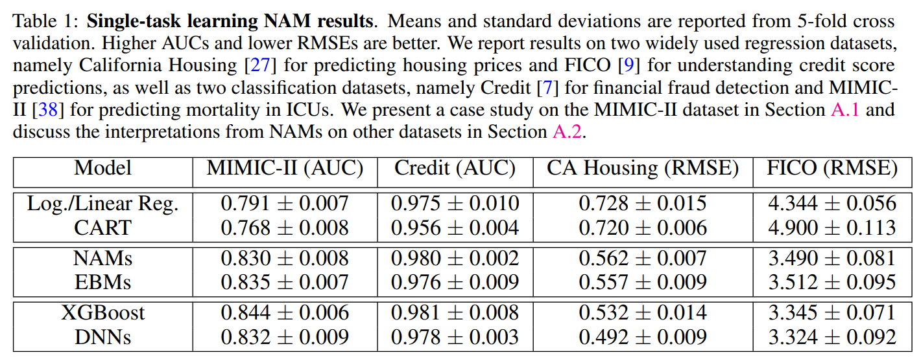
3. Evaluating the Accuracy of NAMs

Slide 11
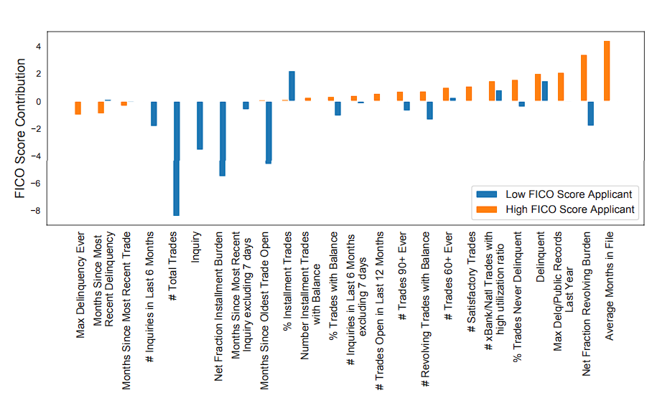
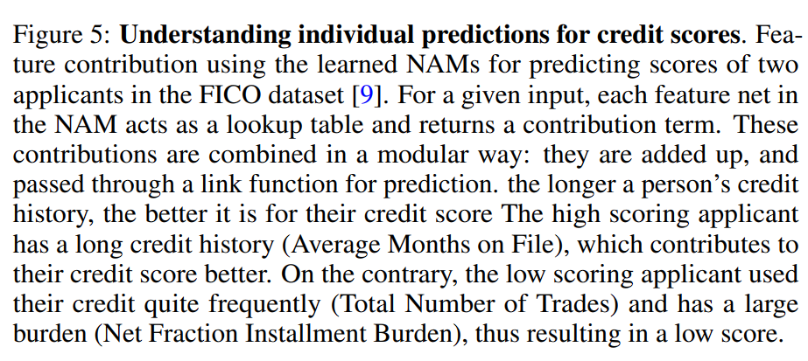
3. Evaluating the Accuracy of NAMs

Slide 12
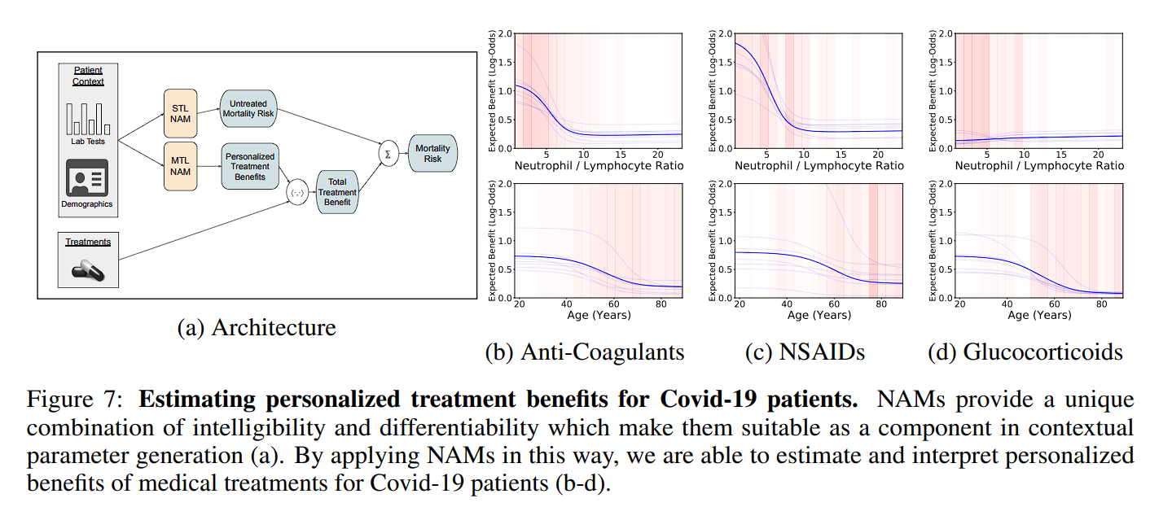
4. Unique Capabilities of NAMs
Leveraging the Differentiability of NAMs

Slide 13
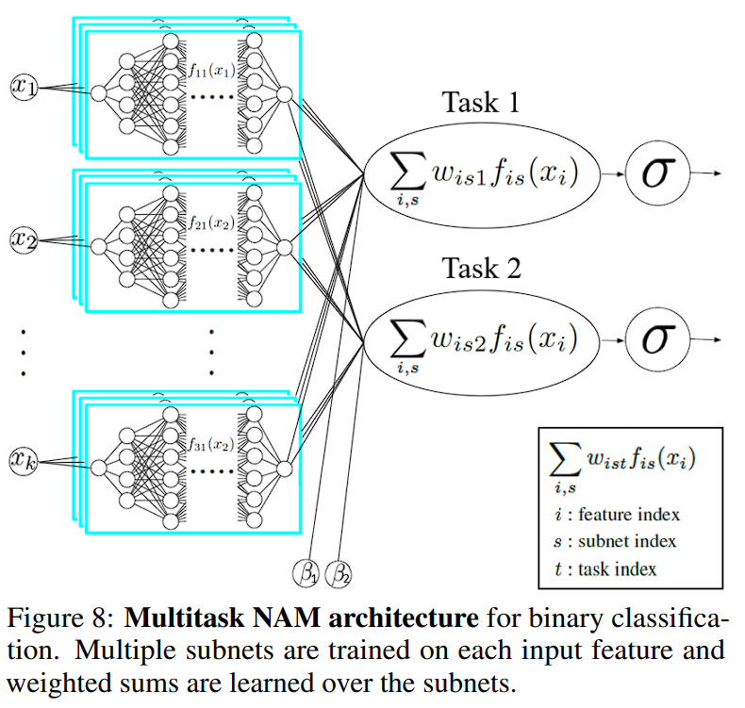
4. Unique Capabilities of NAMs
Multitask Learning
Note that EBM has no a natural extension to the multitask learning

Slide 14
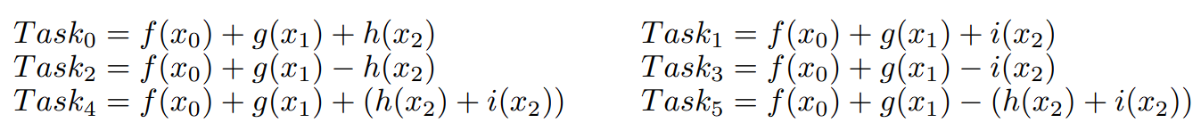
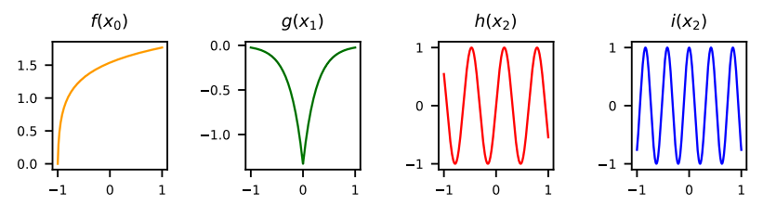
4. Unique Capabilities of NAMs
Experiments on Synthetic Multitask Data

Slide 15
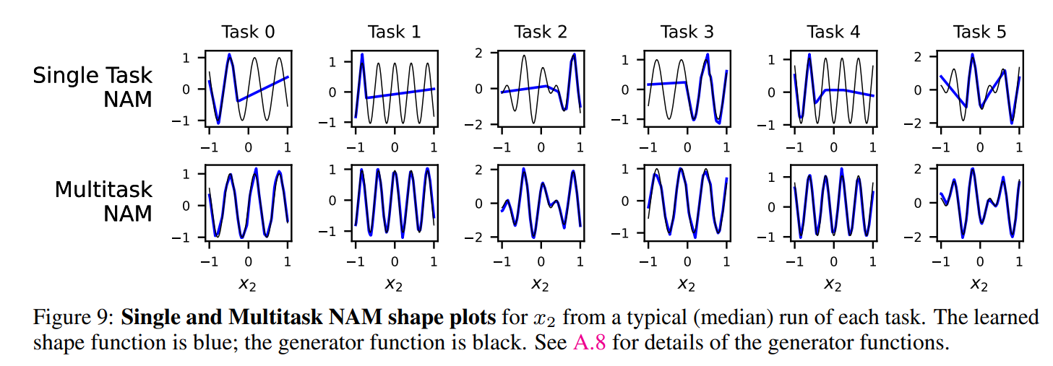
4. Unique Capabilities of NAMs
Experiments on Synthetic Multitask Data

Slide 16
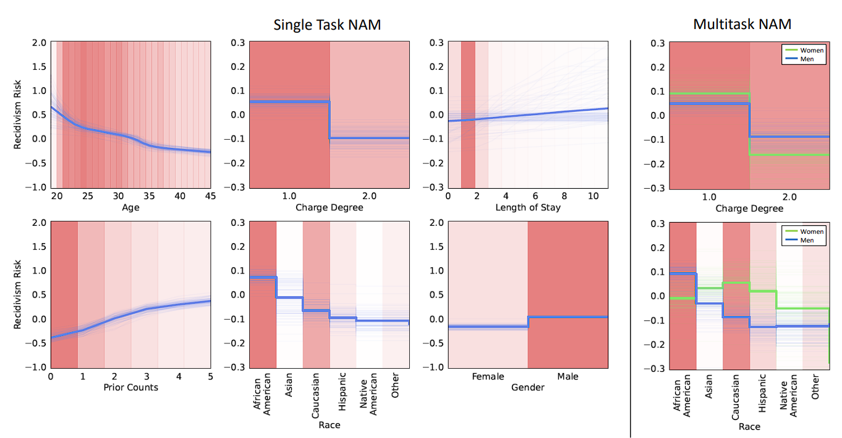
4. Unique Capabilities of NAMs
Single and Multitask COMPAS Recidivism Prediction
The right column of the figure displays a selection of shape plots learned for a multitask NAM trained on the same data as the single task NAM but with Male and Female as separate output tasks.

Slide 17
The end

